Slide 1
Multimedia Systems Lecture – 18
By
Dr. Priyambada Subudhi
Assistant Professor
IIIT Sri City

Slide 2
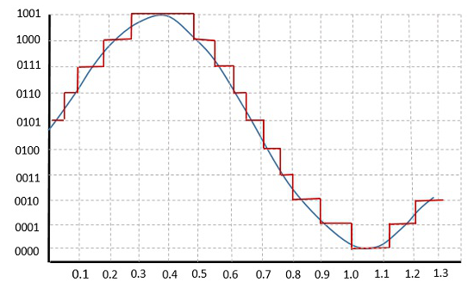
Linear and Nonlinear/ Uniform and Non-uniform Quantization
Samples are typically stored as uniformly quantized values. This is called linear or uniform quantization.

Slide 3
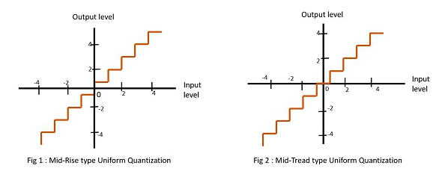
There are two types of uniform quantization. They are Mid-Rise type and Mid-Tread type.
The Mid-Rise type is so called because the origin lies in the middle of a raising part of the stair-case like graph. The quantization levels in this type are even in number.
The Mid-tread type is so called because the origin lies in the middle of a tread of the stair-case like graph. The quantization levels in this type are odd in number.
The difference between an input value and its quantized value is called a Quantization Error.

Slide 4
Non-uniform Quantization
If the quantization characteristic is nonlinear then the step size is not constant and quantization is known as non-uniform quantization.
It is mostly used in case of speech or music as here the variation in amplitude is high which is expressed as crest factor and is given by
crest factor = peak value of signal/rms value of signal
Non-uniform quantization is achieved using companding.

Slide 5
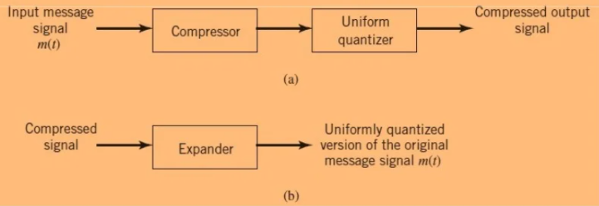
Companding:
It is derived from two words, Compressing and Expanding.
The desired form of non-uniform quantization can be achieved by using compressor followed by a uniform quantizer.

Slide 6
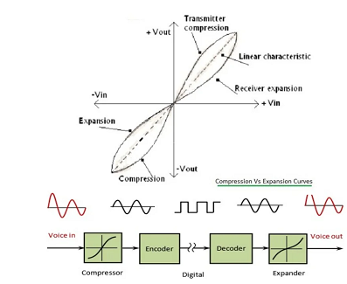
Companding Process

Slide 7

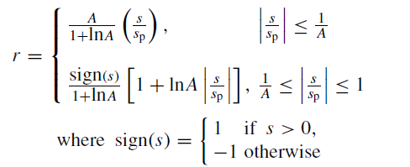
µ-law and A-law companding
µ-law is popular technique used in USA and Japan.
Here the input and output relationship is given by
A very similar rule, called A-law, is used in telephony in Europe.

Slide 8
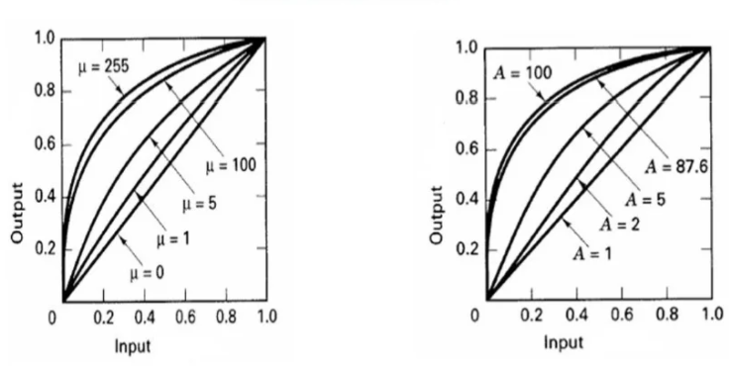
µ-law and A-law Compression Characteristics

Slide 9
Pulse Code Modulation (PCM)
Modulation is the process of varying one or more parameters of a carrier signal in accordance with the instantaneous values of the message signal.
There are many modulation techniques, which are classified according to the type of modulation employed. Of them all, the digital modulation technique used is Pulse Code Modulation.
We know that the basic techniques for creating digital signals from analog ones consist of sampling and quantization.
Pulse Code Modulation, is a formal term for the sampling and quantization we have already been using.
Pulse comes from an engineer’s point of view that the resulting digital signals can be thought of as infinitely narrow vertical “pulses.”

Slide 10
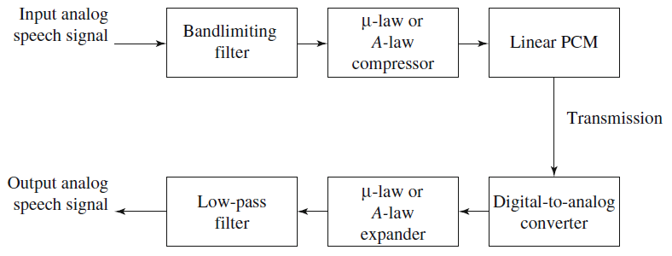
Basic Elements of PCM

